Slide 1
Bron24 Task-1
Represented By - Dhruv Dhayal
Vision of the Feature
Bron24 should become a platform where players not only book grounds but also build teams, find players, organize matches, interact socially, and grow a sports community.
Main goal:
Increase daily engagement
Build retention
Create active sports communities
Reduce dependency only on bookings

Slide 2
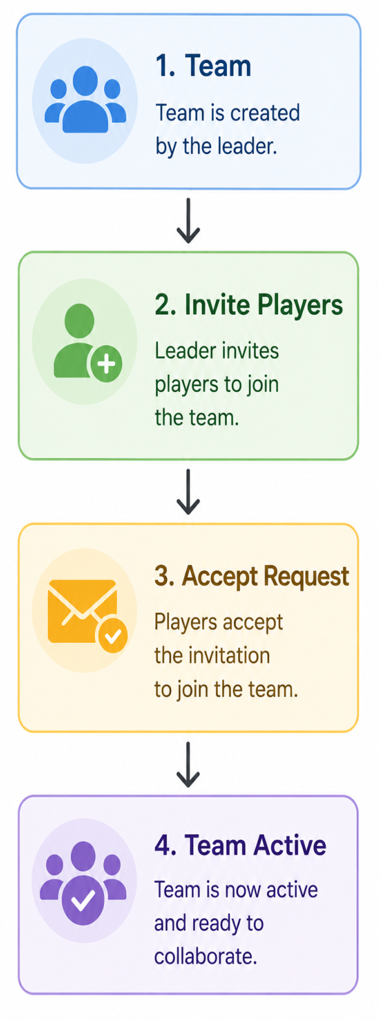
2. Main Features
Team Creation System
Users can:
Create public like random/private teams like Friend circle type
Add team logo/banner
Invite players
Assign captain/admin
Mention sports type: Football, Basketball and other games.
Backend Logic
Entities:
Users
Teams
Team Members
Team Roles
Database Tables
Users Teams Team Members Team Invites

Slide 3
3. Find Players Feature (This can become the strongest feature.)
Problem:
Many people:
Don’t have enough players
Need substitutes
Want nearby players
Solution
“Find Players Nearby”
Users can:
Post match requirement
Mention: location, sports Timing, Required Players
Features
Geo-location search
Match recommendations
Player matching algorithm
Finding the Players for Games Depends on Two Category
Private | Public
Like Friend Circle | Geo-location search the user who also looking to search someone to play.
Already Planned Family Members | e.g: like taxi apps where we can find taxi here we can find players who looking someone as team player to play same game send Invite->plan->play

Slide 4
4. Social Feed System (Posts/Stories, etc……) This increases retention massively.
Users after making profile can:
Upload posts
Upload stories
Share match moments
Upload goals/highlights
Tag teammates (friends, families, etc….)
Like/comment to other players posts, stories increases engagement and all.
Suggested Feed Types
Posts
Permanent content.
Stories
Disappear after 24 hours.
Match Highlights
Short clips/photos after games.

Slide 5
4.1. Player Profile System
Profiles should feel like athlete profiles.
Profile Includes Name, Sports, Skill level, Matches played, Win ratio, Position, Ratings, Achievements
4.2. Skill Based Matchmaking
This can become Bron24’s unique feature.
Instead of random players:
Beginner
Intermediate
Advanced
Professional
Users get matched accordingly.
For Example
Dhruv Football Midfielder 42 Matches 4.8 Rating

Slide 6
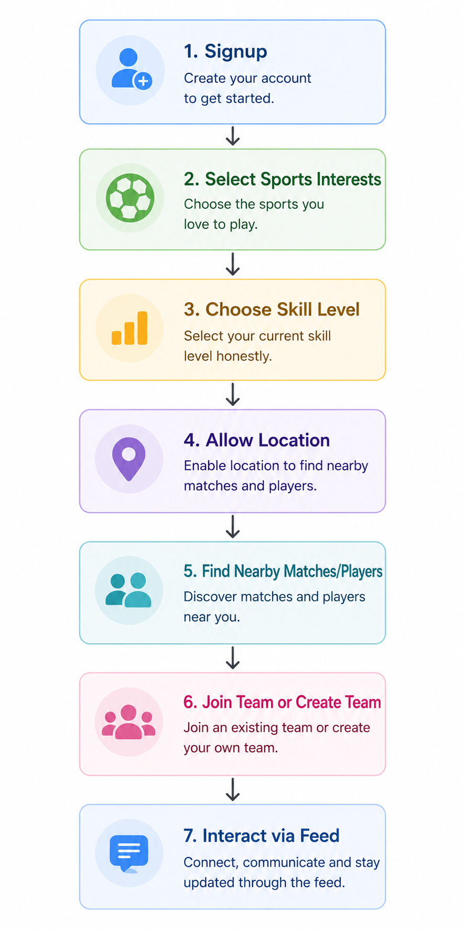
4.3. Ratings & Reputation System
After matches:
Players rate each other
Suggestion and comment section tells about like(location, clubs facility and all is good bad, timings, equipment's available or not this and that)
Improve trust
Categories:
Sportsmanship
Teamwork
Punctuality
4.4 Real-Time Features
This is where backend becomes important.
Use Cases
Live invitations
Match joining updates
Team chats
Notifications
Real-time booking status

Slide 7
5. Main Screens
Core Screens
Home Feed
Discover Players
Teams, Match Requests
Chat, Booking
Profile
Notifications
6. Backend Architecture Suggestion
Authentication Service: JWT auth, OAuth
Team Service: Team management, Invitations
Match Service: Match creation, Scheduling
Feed Service: Posts/stories/comments
Notification Service: Push notifications
Recommendation Engine: Nearby players, Skill matching

Slide 8
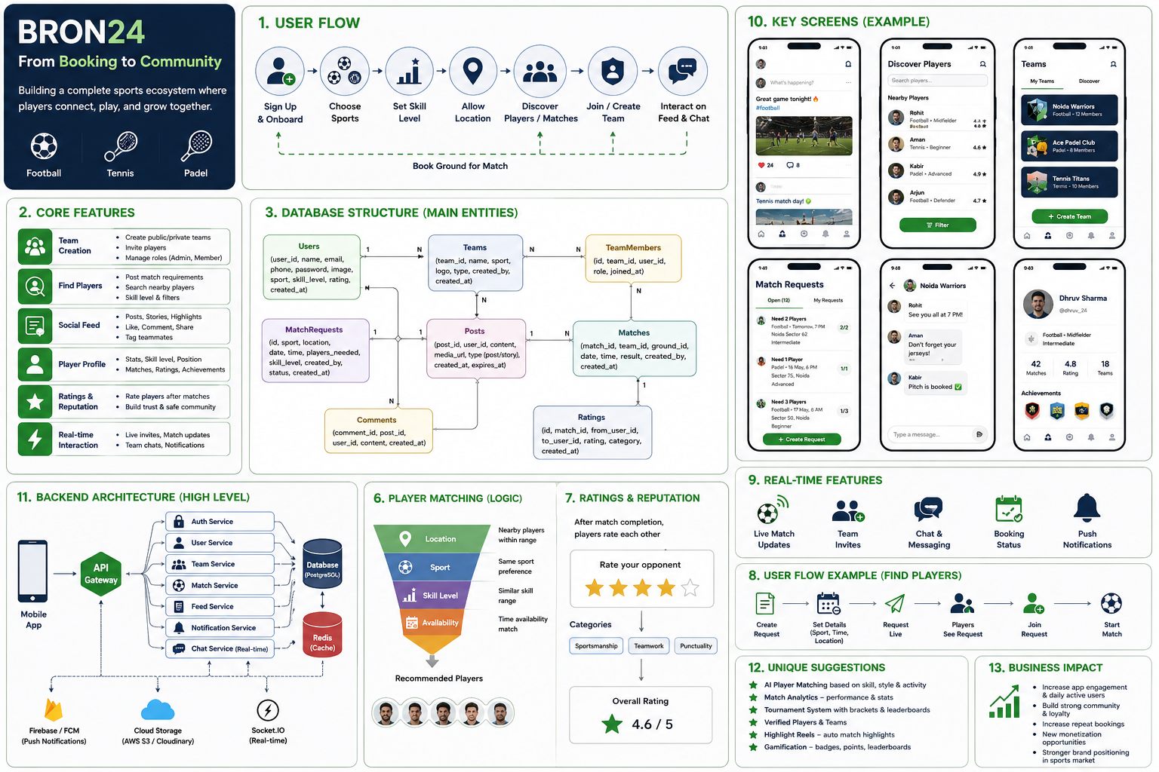

Slide 9
7. Unique Suggestions
A. AI Player Matching Recommend players based on skill level, location, play style, and activity using AI.
B. Match Analytics Track goals, assists, ratings, and performance statistics after every game.
C. Tournament System Allow users to create tournaments, manage brackets, and view leaderboards.
D. Verified Players Provide verification badges to trusted and genuine users.
E. Scalability
Implement the Chabot System Integration to guide new upcoming users, sportsperson and all.
8. Business Impact
Increases user engagement
Improves repeat user activity
Builds strong community loyalty
Creates monetization opportunities
Indirectly boosts venue bookings

Slide 10
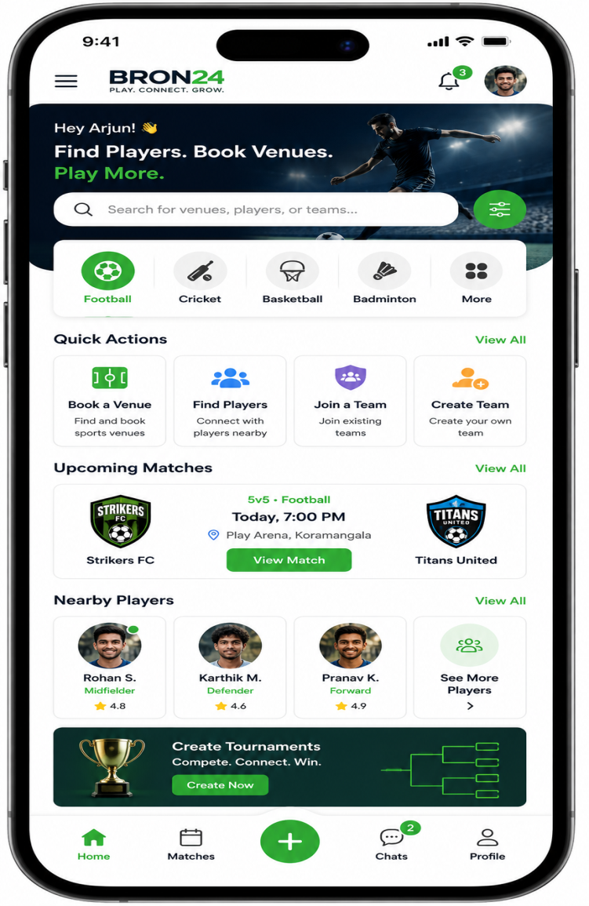
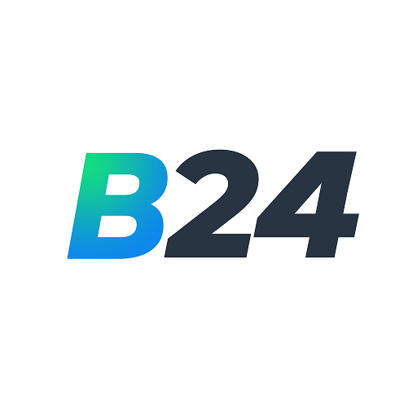
9. Final Closing Statement
Bron24 should not feel like only a booking application. It should feel like a digital sports ecosystem where players connect, compete, communicate, and grow together as a community.
This kind of response will make you look:
Product-oriented
Startup-minded
Backend-aware
Scalable-thinking
Serious about engineering

